Slide 1




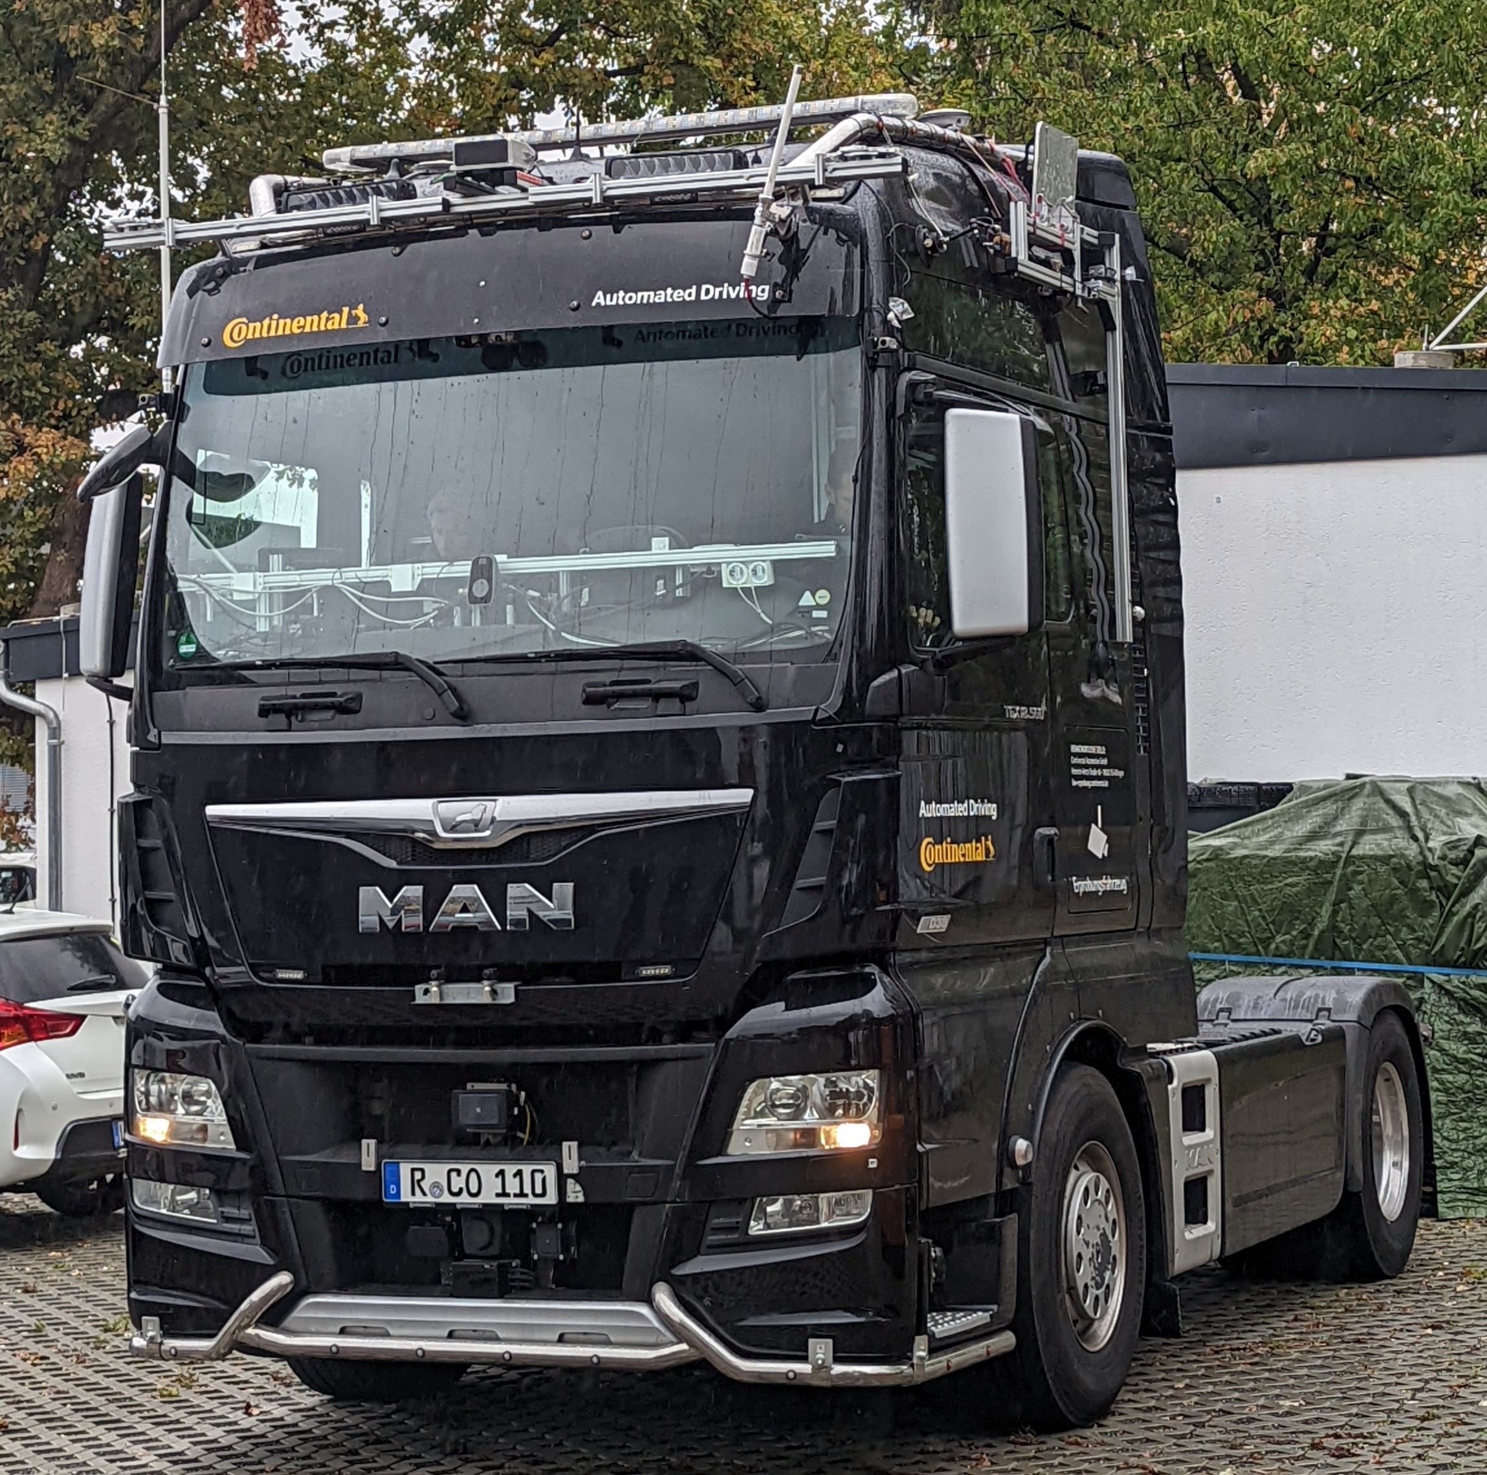





{hackathon}
Hack the Truck
BCX Challenge 1
Goal of the challenge:
Do you dream big? Do you want to hack a real truck? Let’s climb up into the cockpit and get creative!
Use the input / output devices of the truck in combination with the eCAL middleware to realize any project you can think of.
Data source & actuators:
LED bar
Cameras
LiDAR
Steering wheel
Example hacks:
Detect passengers with the truck's cameras and indicate it on the roof-mounted LED bar
Emulate a gamepad based on the truck's steering wheel and control your favorite racing game
Buttons
Brake pedal
Radar
Blinkers
Example architecture:
Projects involved:

